Slide 1
The International School and Conference on Quantum Information
Institute of Physics (IOP), Bhubaneswar
Experimental aspects of optical quantum information
Anindita Banerjee
Quantum optics Lab
Department of Physics
Centre of Astroparticle Physics and Space Science
Bose Institute

Slide 2
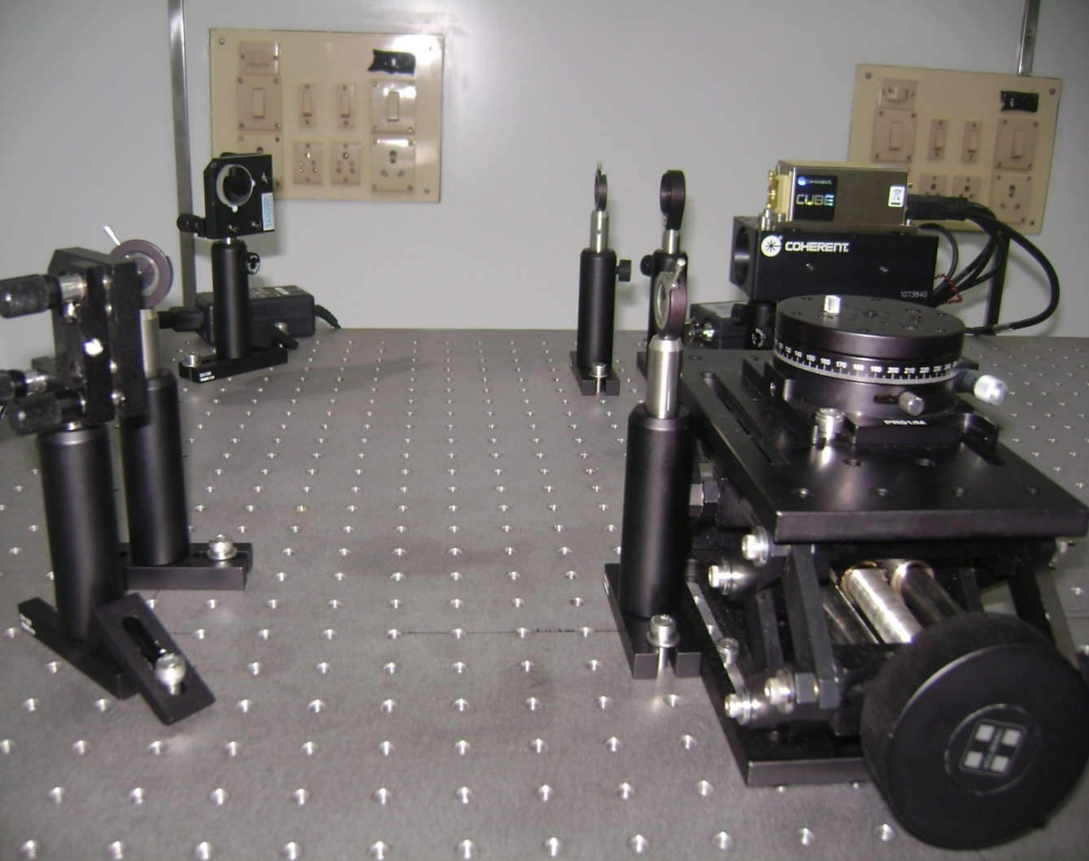
Quantum Optics Lab
We aim to do quantum optics experiments at undergraduate level
using single photons.
Notes:
2
2
2

Slide 3
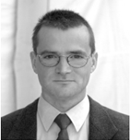
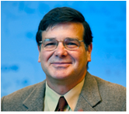
Groups working on single photon experiments for undergraduate laboratory
Prof Jan-Peter Meyn and
Dr. Patrick Bronner
Quantum optics experiments as a basis for a quantum physics curriculum
Porf. Kiko Galvez
Colgate University,
New York
Prof. Mark Beck
Whitman College,
Walla Walla, WA
Modern Undergraduate Quantum Mechanics Experiments,
Physikalisches Institut - Didaktik der Physik Universität Erlangen-Nürnberg Germany
Prof. Konrad Banaszek
Instytut Fizyki Teoretycznej Uniwersytet Warszawski Poland
Optical implementations of quantum information processing and communication.
Prof. R. P. Singh
Quantum Optics & Quantum Information Group Physical Research Laboratory,
Ahmedabad-380009, INDIA.

Slide 4
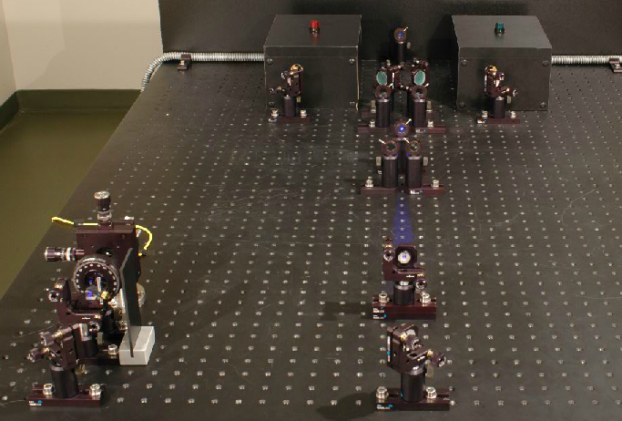
Physikalisches Institut - Didaktik der Physik Universität Erlangen-Nürnberg, Germany

Slide 5
Outline
SPONTANEOUS PARAMETRIC DOWN CONVERSION
SET UP: OPTICAL COMPONENTS
DETECTORS
ELECTRONICS
UNDERGRADUATE EXPERIMENTS
QUANTUM COMMUNICATION

Slide 6
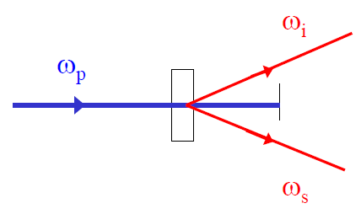
Spontaneous
Parametric
Down Conversion
Energy Conservation:
Momentum Conservation

Slide 7
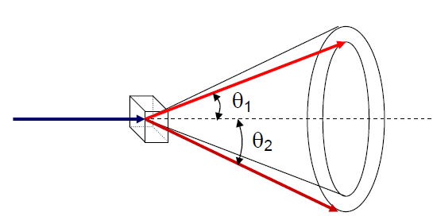
Down converted light is all over
The light coming out of a down conversion crystal is emitted into a range of angles (up to a few degrees) and wavelengths (on the order of 10s of nm, centered about twice the pump wavelength.

Slide 8
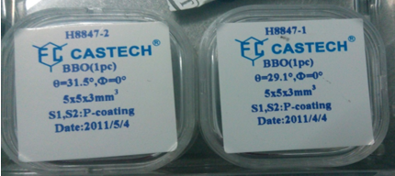
The indices of refraction for ordinary and extraordinary rays BBOas a function of wavelength:
For Type-I phase matching, DC light is polarized perpendicular to the optic axis . The polarization of the pump beam is in the same plane as optic axis.
Phase matching angle for Type -I down conversion of 407nm with BBO is 29.0857 [+/-3degree]
Phase matching angle for Type -I down conversion of 407nm with BBO is 28.663 [collinear]
Phase matching angle for Type -I down conversion of 377nm with BBO is 31.4117 [+/-3degree]
Phase matching angle for Type -I down conversion of 377nm with BBO is 31.0128 [collinear]
Therefore BBO with theta= 31.5 is for Type-I for 377nm non collinear
BBO with theta= 29.1 is for Type-I for 407nm non collinear
Notes:
8
8
8

Slide 9
Fast axis Slow Axis
Optic axis
Ordinary ray Extraordinary ray
ne < no: negative uniaxial crystal
ne > no: positive uniaxial crystal
Type-1: in both twin photons the polarizations are parallel
Type-2: in both twin photons the polarizations are orthogonal
Notes:
Optic axis is the axis that has a different index of refraction also called c or crystallographic axis
Fast axis: axis with smallest index of refraction ray of light going through uniaxial crystal is (generally) split into two rays ordinary ray (o-ray) passes the crystal without any deviation
Extraordinary ray (e-ray) is deviated at air-crystal interface two emerging rays have orthogonal polarization states
ne < no: negative uniaxial crystal
ne > no: positive uniaxial crystal

Slide 10
Number of down converted photons
Can you count the Total number of photons in a 377nm laser at 10mW
Using E = hc/λ we can find out how much energy a single photon of wavelength 377nm has. E = Planck Constant * Speed of Light/377nm The number of photons will be total energy over the energy per photon n = 2 x 10¹⁶ photons
Only one in billion (10⁹) will undergo SPDC !
i.e. Around some 10⁶
AND THIS IS MY SOURCE AND ITS FREE SPACE
Notes:
1 billion (short scale, 10^9) is 100 crore. 1 crore is equal to 100 lakh or 10 million (10^7). Short scale 10^6 = 1 Million (10 lakh) 10^9 = 1 Billion (100 crore) 10^12 = 1 Trillion (1 lakh crore)

Slide 11
Timing
Photons are produced at the same time
BUT NOT EXACTLY SAME TIME
The uncertainty in the time is given approximately by the inverse of the bandwidth of the down converted light:
Notes:
BECAUSE OF INDERTERMINANCY OF ENERGY AND TIME IS GIVEN BY
E deltaT>=plancks constat/2;
For our experimental parameters the uncertainty in time is on
the order of 10 fs—a time that is much shorter than our experimental apparatus can
resolve.

Slide 12
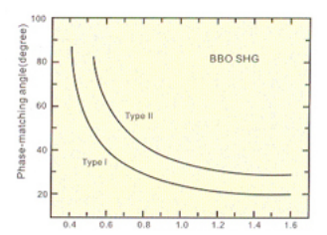
Beta-Barium Borate (β-BaB₂O₄,BBO)
BBO is a negative uniaxial crystal, with ordinary refractive-index(n_{o}) larger than extraordinary refractive-index(n_{e}).Both type I and type II phase-matching can be reached by angle-tuning. The phase matching angles of frequency doubling are shown
The phase matching angles of frequency doubling
SHG tuning curves of BBO
PRECAUSIONS: BBO has a low susceptibility to the moisture. The user is advised to provide dry conditions for both the use and preservation of BBO. BBO is relatively soft and therefore requires precautions to protect its polished surfaces.
http://www.castech.com/products_detail/&productId=0d072b30-2679-41d5-ba54-d433913b10b9.html
Notes:
For a given pump frequency ω3, the solutions of energy and momentum conservation, ω1 and ω2, are often plotted versus the angle θ, a plot known as the tuning curve.

Slide 13
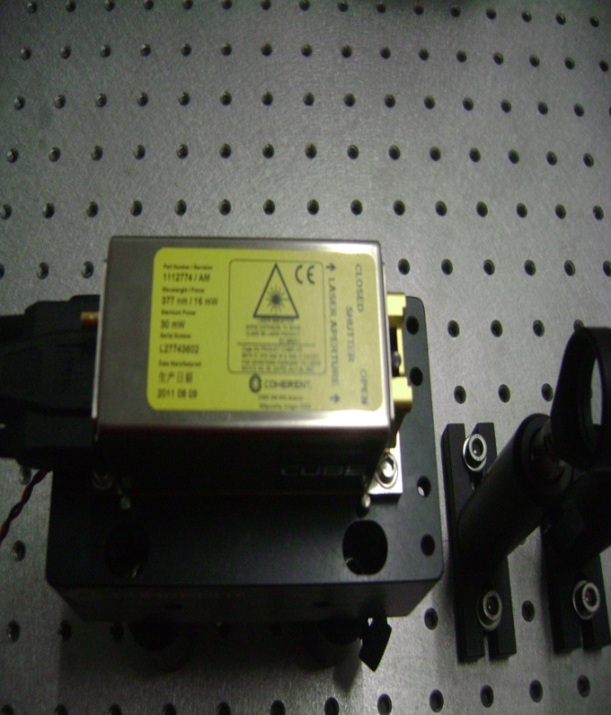
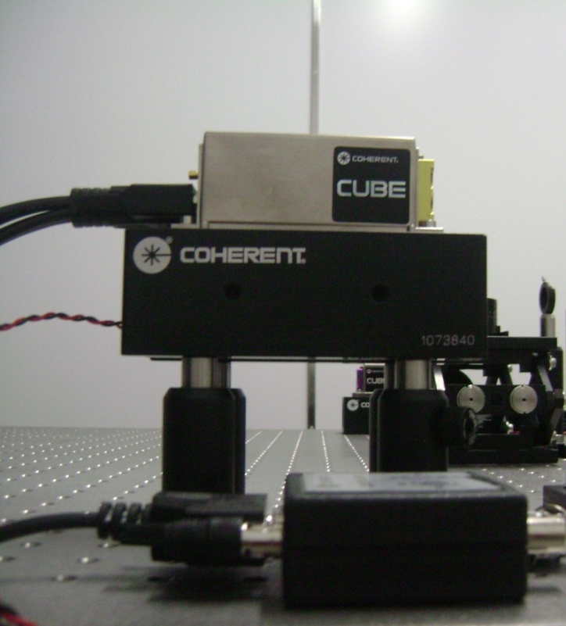
LASER
Laser-1
407nm
50mW
Laser-2
377nm
16mW
Semiconductor Lasers

Slide 14
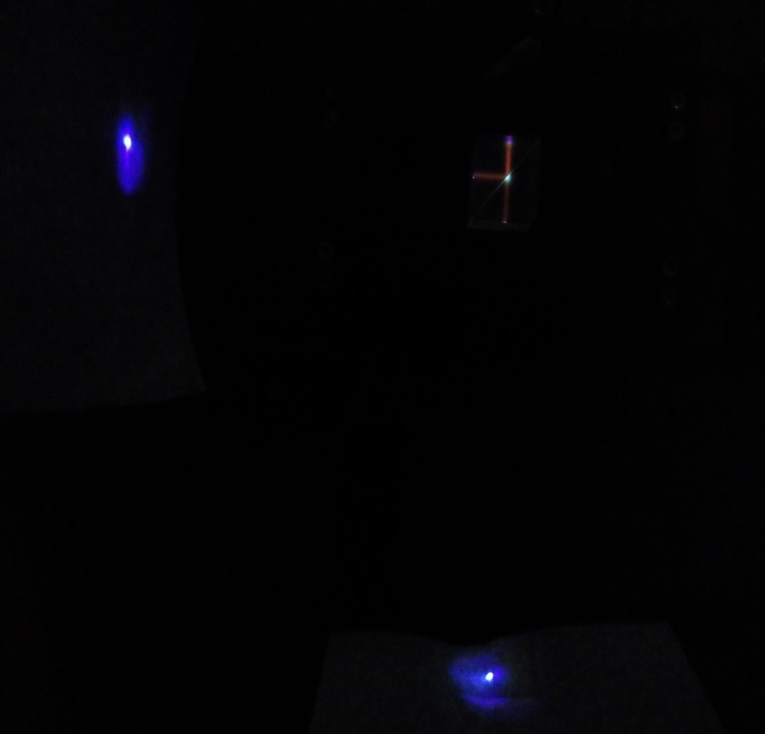
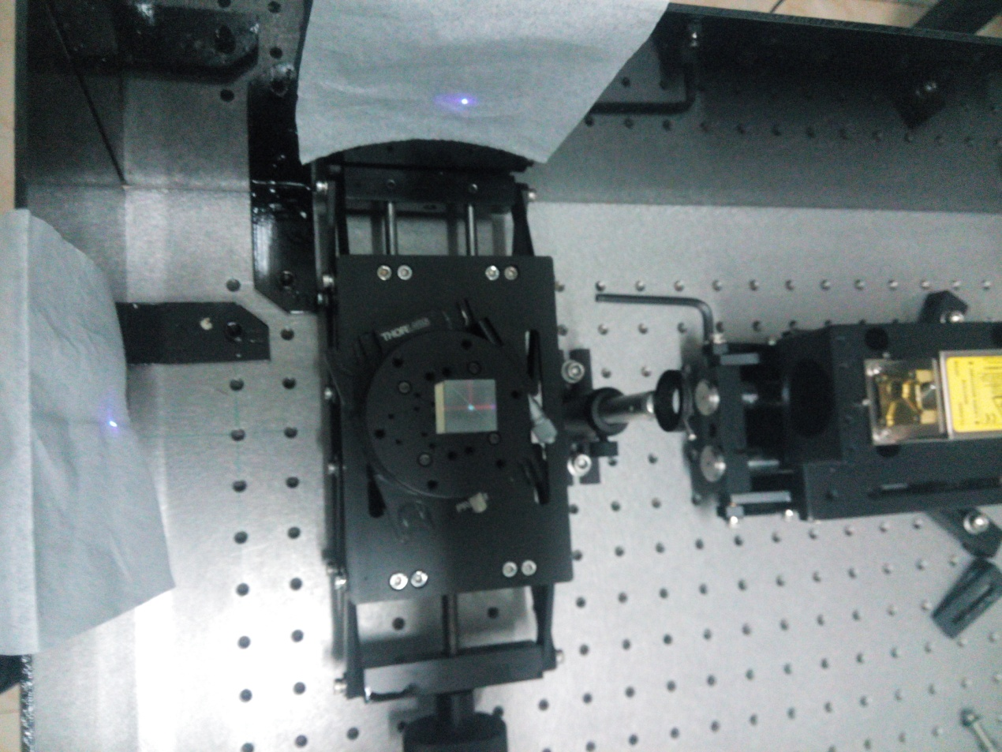
Beam Splitter

Slide 15
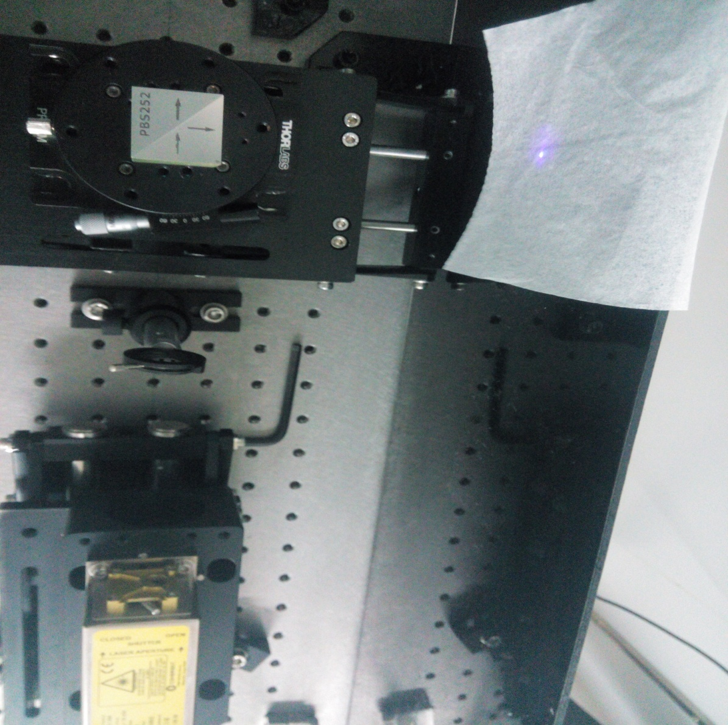
Polarizing Beam Splitter

Slide 16
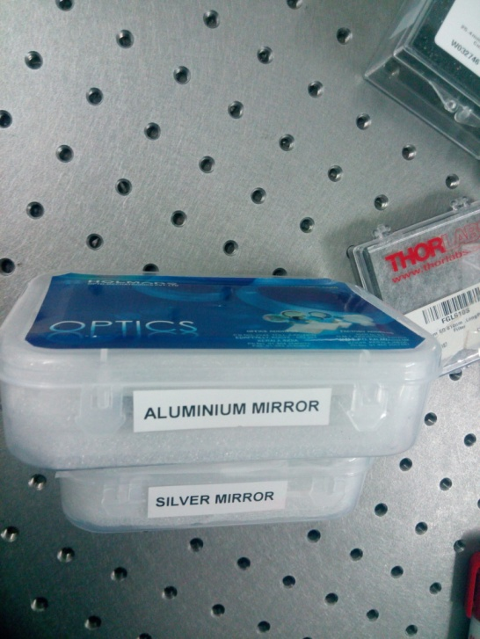
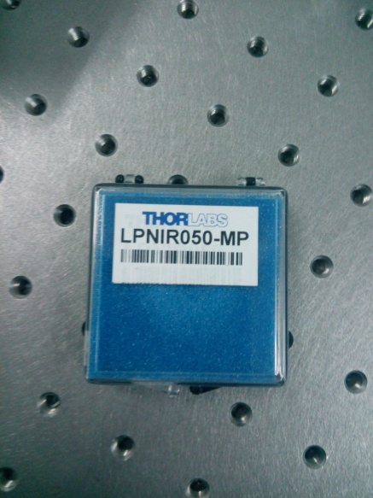
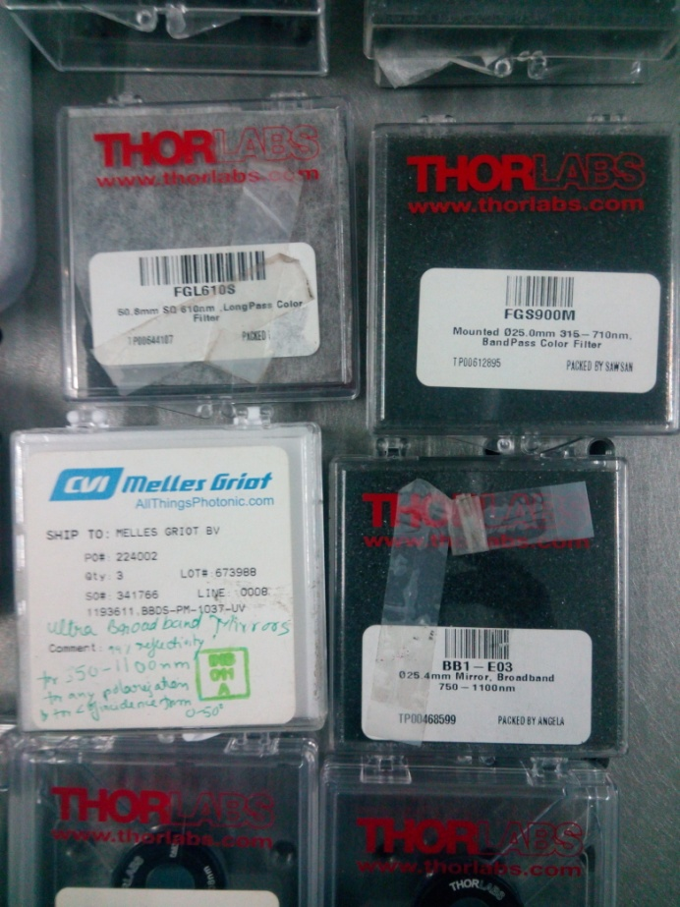
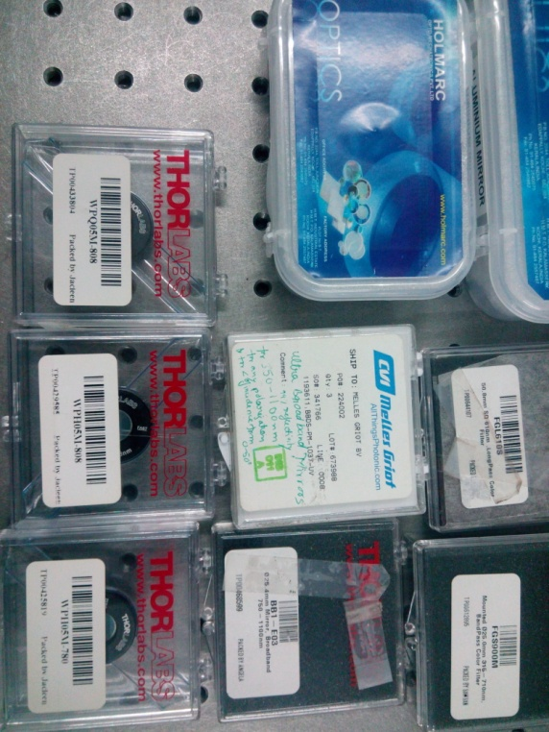
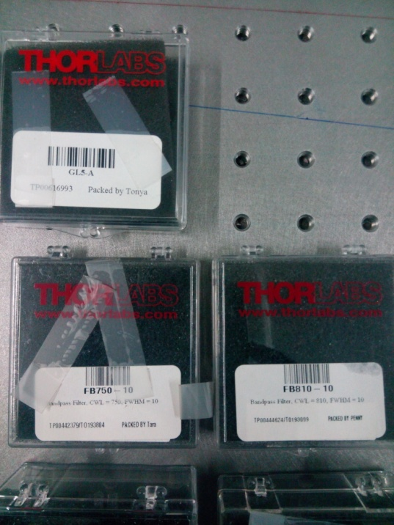
Some Linear
Optical elements

Slide 17
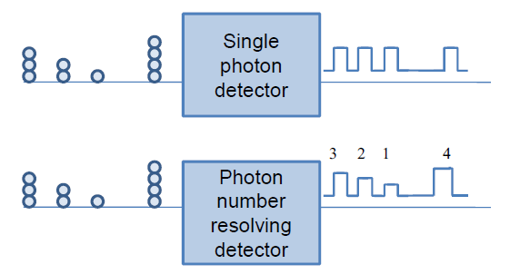
Detectors
Single photon detectors are very important for the implementation of the protocols for quantum computation and
secure quantum communication
PMT not preffered

Slide 18
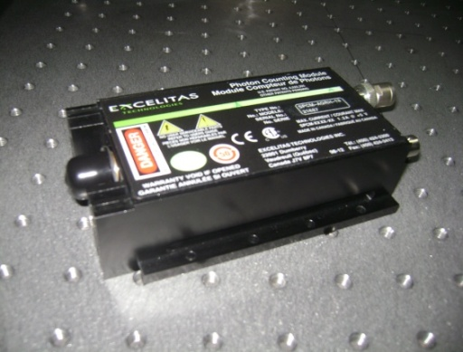
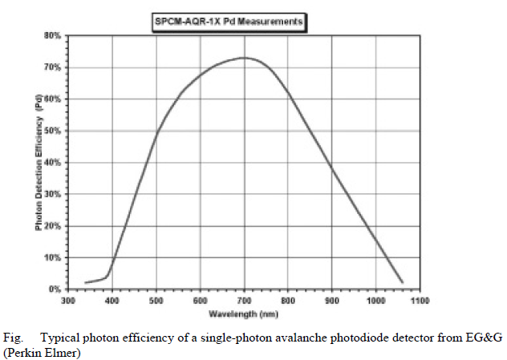
Single Photon Detector
Detects 20 million photons per second
Active area 0.25mm
Notes:
18
18

Slide 19
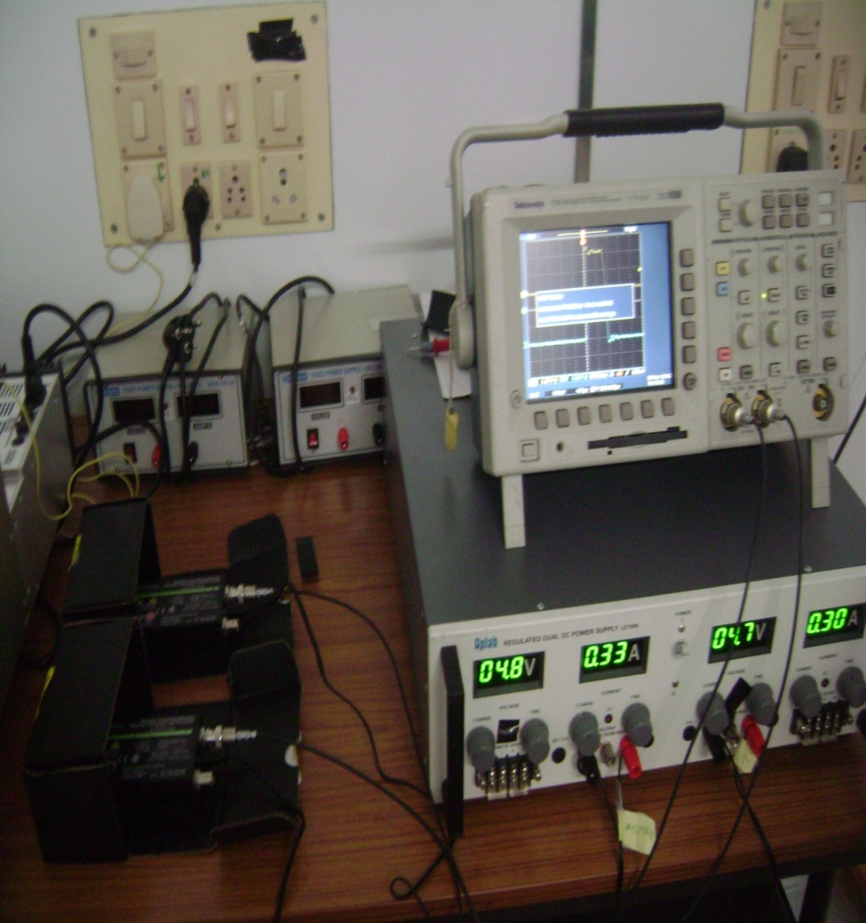
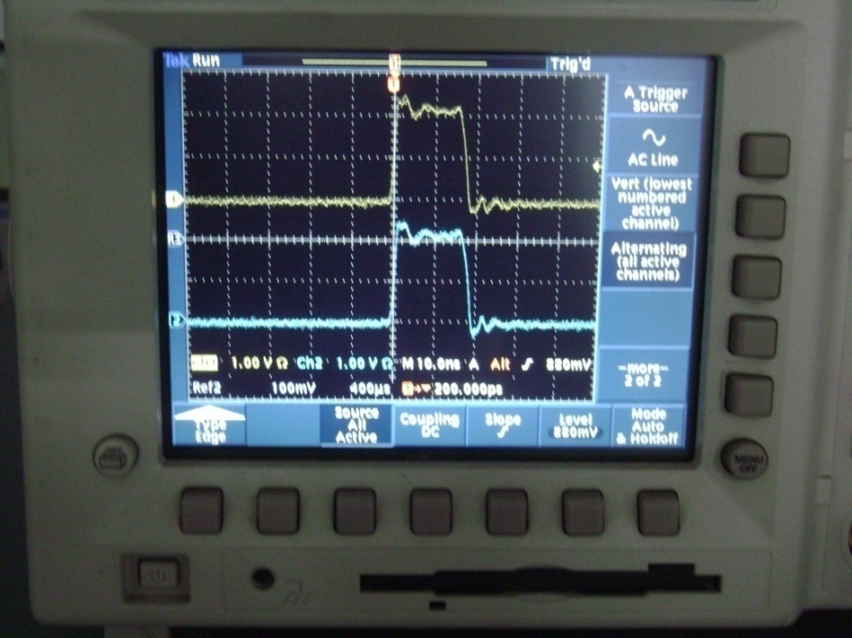
As a photon is detected a TTL pulse
of 2.5V high in a 50 ohm load and 15ns
wide is given at the output
Detector Signal

Slide 20
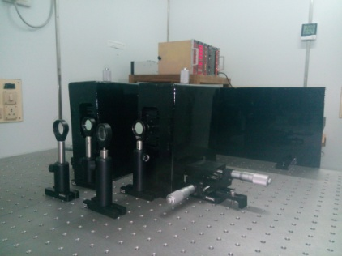

Slide 21
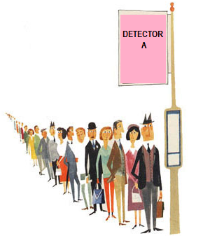
Alignment
Beam should be parallel to the table.
Beam should of the same height throughout.
Components should be placed orthogonal to the optics.
Laser should be falling at the centre of the optics.
And Some Rules for Electronics
And Some rules for Detector
DOWN CONVERTED PHOTONS

Slide 22
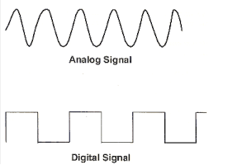
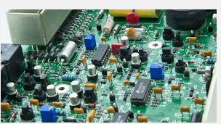
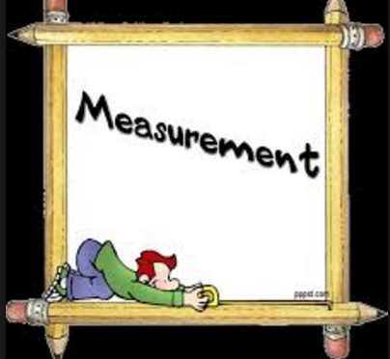
ELECTRONICS
Measure what is measurable,
and make measurable what is not so.
- Galileo Galilei

Slide 23
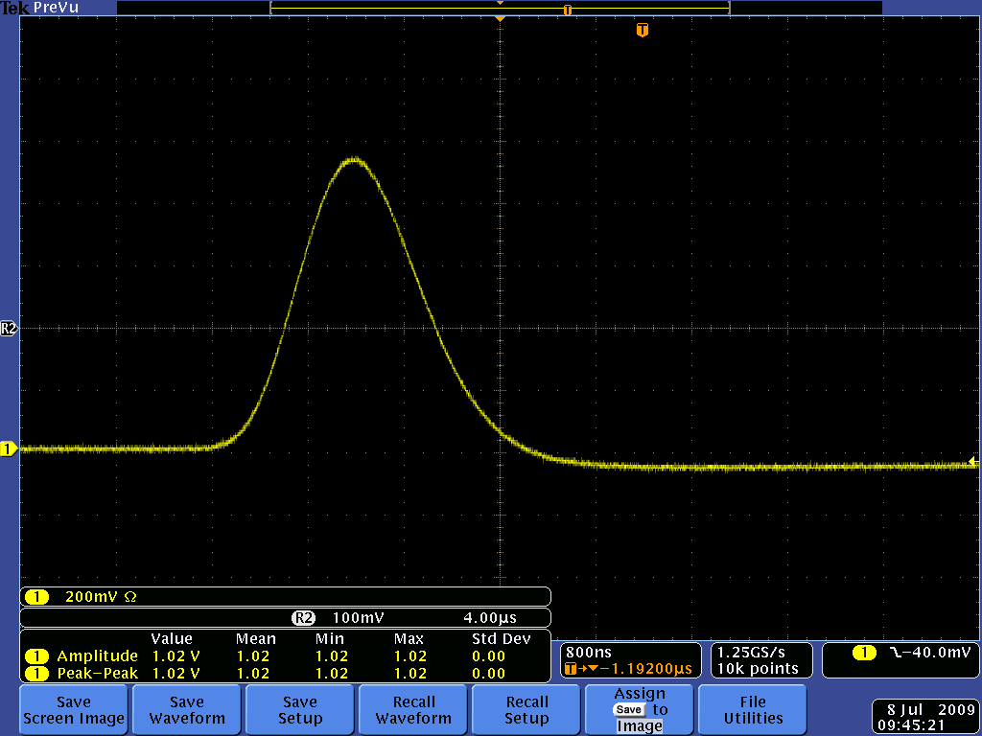
Pulse : Where are the information?
Brief surges of current or voltage in which information may be contained
in one or more of its characteristics – polarity, amplitude, shape etc.
Baseline
Pulse height or Amplitude
Signal width
Leading edge / Trailing edge
Rise time / Fall time
Unipolar / Bipolar

Slide 24
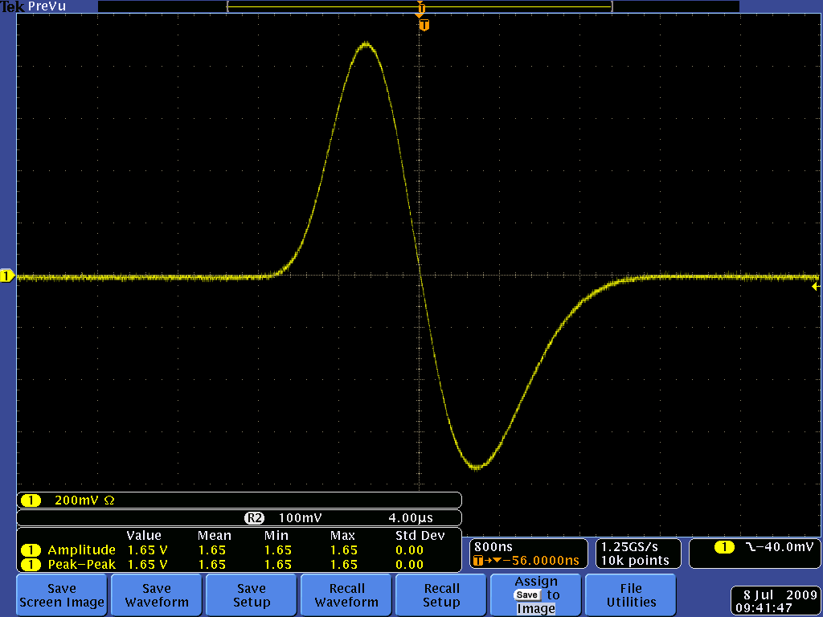
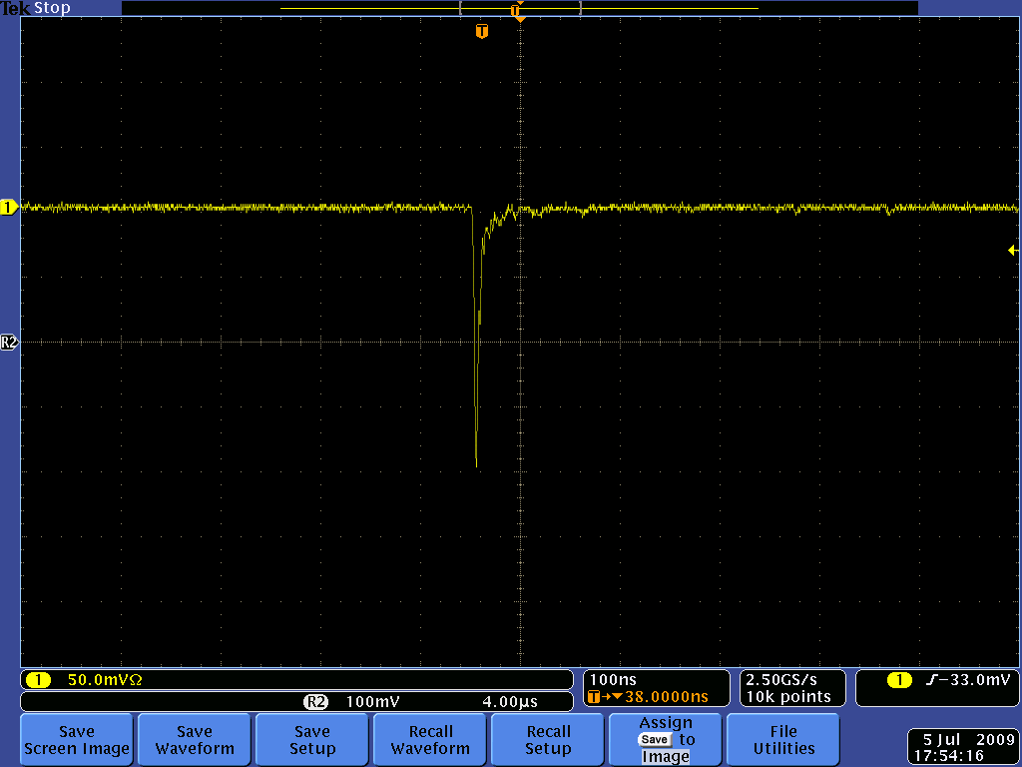
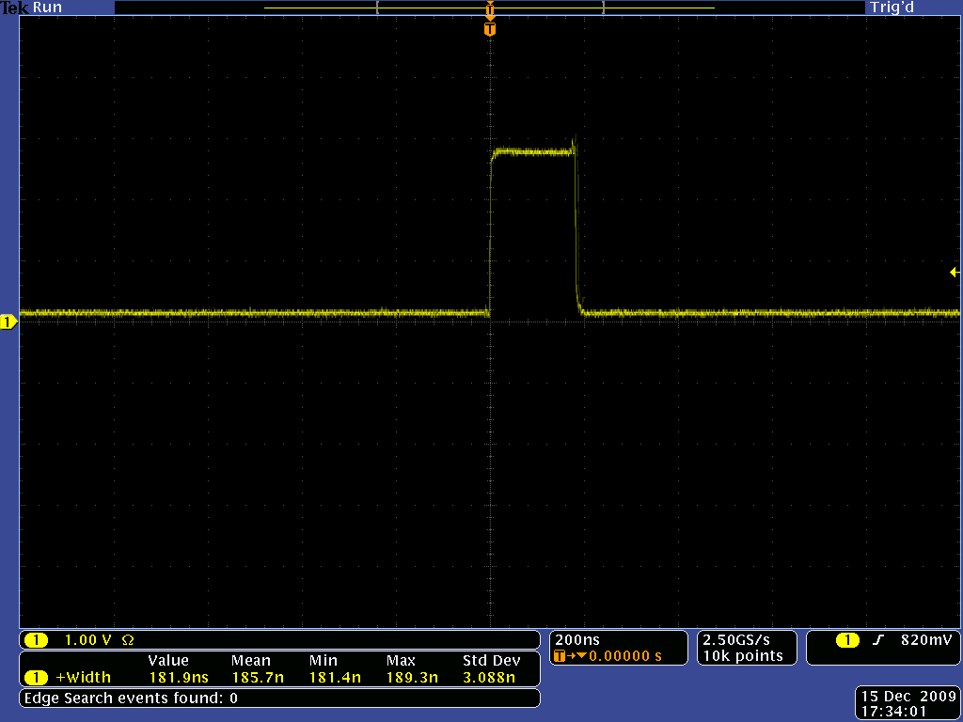
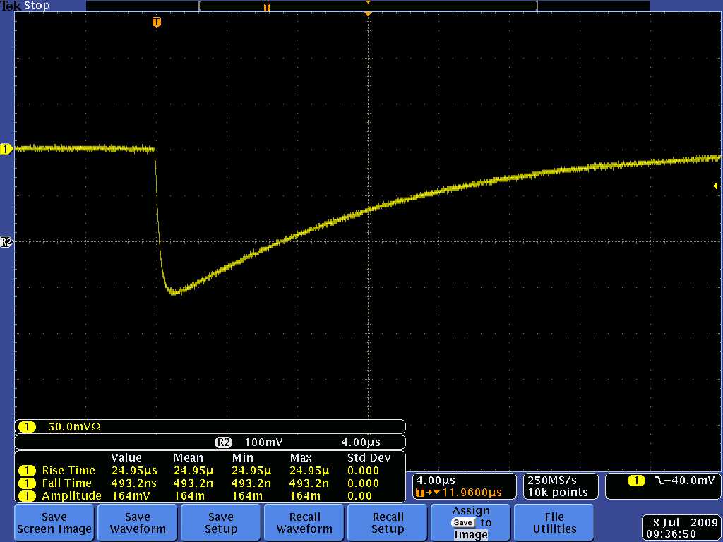
Pulse : How do they look?
Analog or digital?
Fast or slow?
Amplitude or shape varies continuously
Proportionately with the information
signal from microphone
signal from proportional chamber
Rise time – a few nanoseconds or less
Quantized information in discrete number
of states (practically two)
pulse after discriminator
Rise time – hundreds of nanoseconds or
greater

Slide 25
Logic standards
Nuclear Instrumentation Module (NIM)
Fast negative NIM
Slow positive NIM
 | O/P must deliver | I/P must accept
Logic 1 (high) | -14 mA to -18 mA | -12 mA to -36 mA
Logic 0 (low) | -1 mA to +1 mA | -4 mA to +20 mA
 | O/P must deliver | I/P must accept
Logic 1 (high) | +4 V to +12 V | +3 V to +12 V
Logic 0 (low) | +1 V to -2 V | +1.5 V to -2 V
Transistor-Transistor Logic (TTL) and Emitter Coupled Logic (ECL)
 | TTL | ECL
Logic 1 (high) | 2 – 5 V | - 1.75 V
Logic 0 (low) | 0 – 0.8 V | -0.90 V

Slide 26
Signal transmission
Signal is produced at the detector – one needs to carry it till the Data
Acquisition system – How?
One solution (the best one), Coaxial cable :
Two concentric cylindrical conductors separated by a dielectric material – the outer conductor
besides serving as the ground return, serves as a shield to the central one from stray
electromagnetic fields.
Characteristic Impedance :
All coaxial cables are limited to the range between 50 – 200 Ω. Why?

Slide 27
Pulse processing - instruments
NIM
Physical/mechanical parameters :
width – 19” (full crate)
width of the slot – 1.35”
height – 8.75”
Electrical parameters :
+/- 24 V, +/- 12 V, +/- 6 V, +/- 3 V (sometimes)
connector
connector

Slide 28
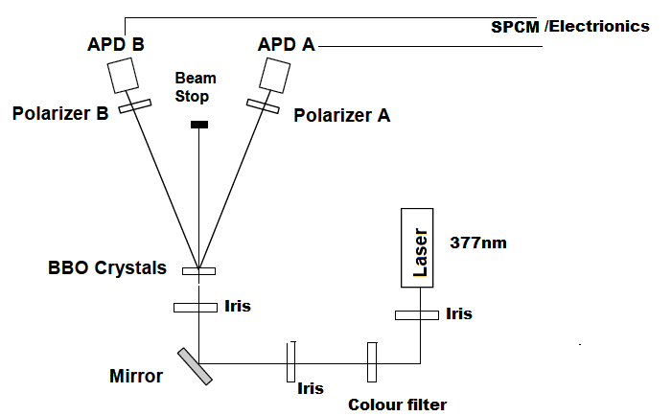
Experiment 1
Notes:
28
28
28

Slide 29
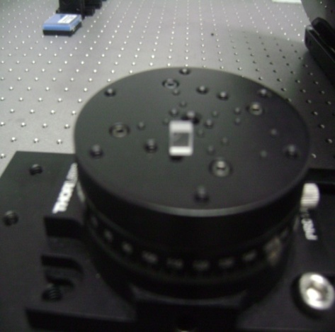
Working of BBO
Rotated placing in inside circular frame
Rotated it in angular mount

Slide 30
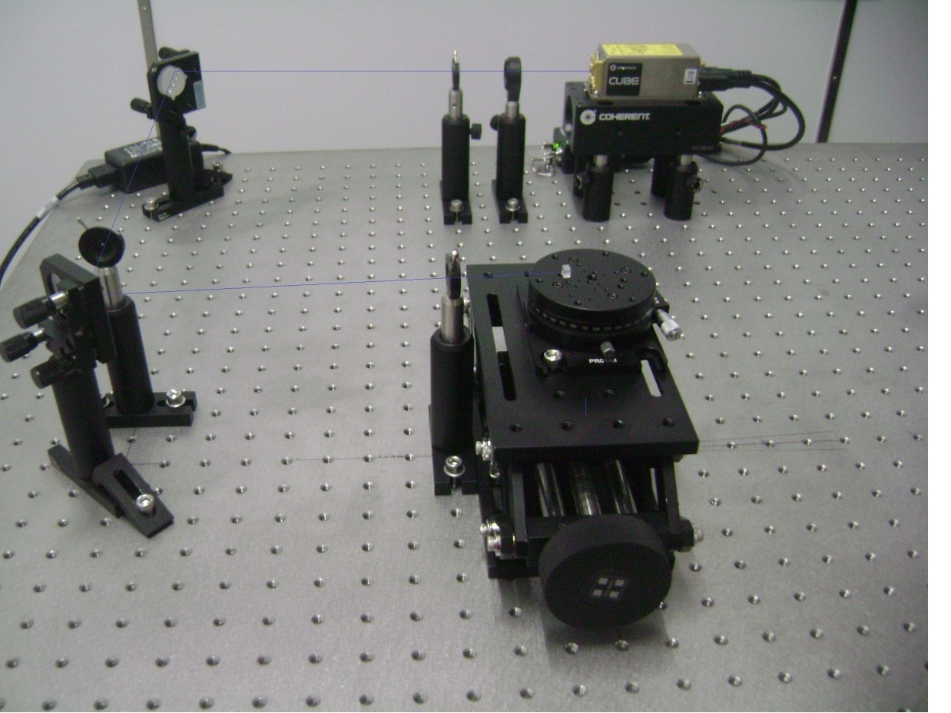
Type I SPDC

Slide 31
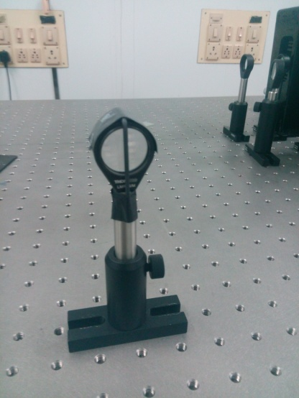

Slide 32
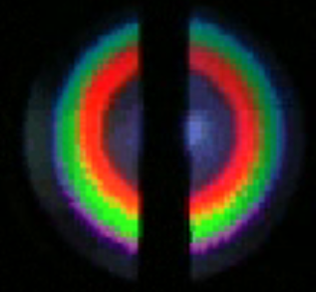
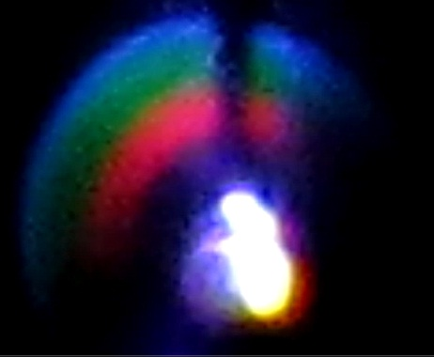
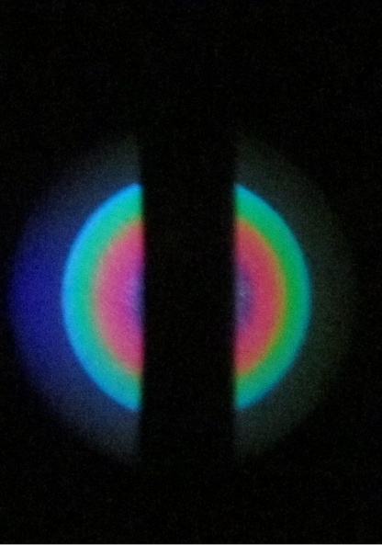
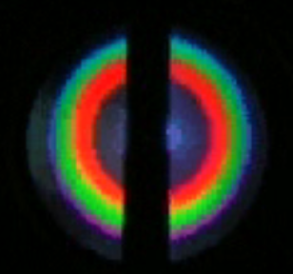
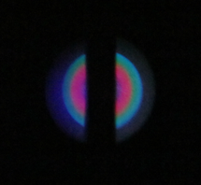
Zeilinger et al.
Our Lab

Slide 33
Counting coincidences
FAN OUT COUNTER TTL/NIM LOGIC UNIT
P
O
W
E
R
S
U
P
P
L
Y
DETECTOR
And/OR
DETECTOR
LOAD
COUNTS OBTAINED SO FAR:
DARK COUNT: 140/sec
AMBIENCE: 450/sec
LASER 377nm and filter: 917/sec
Notes:
33
33
33

Slide 34
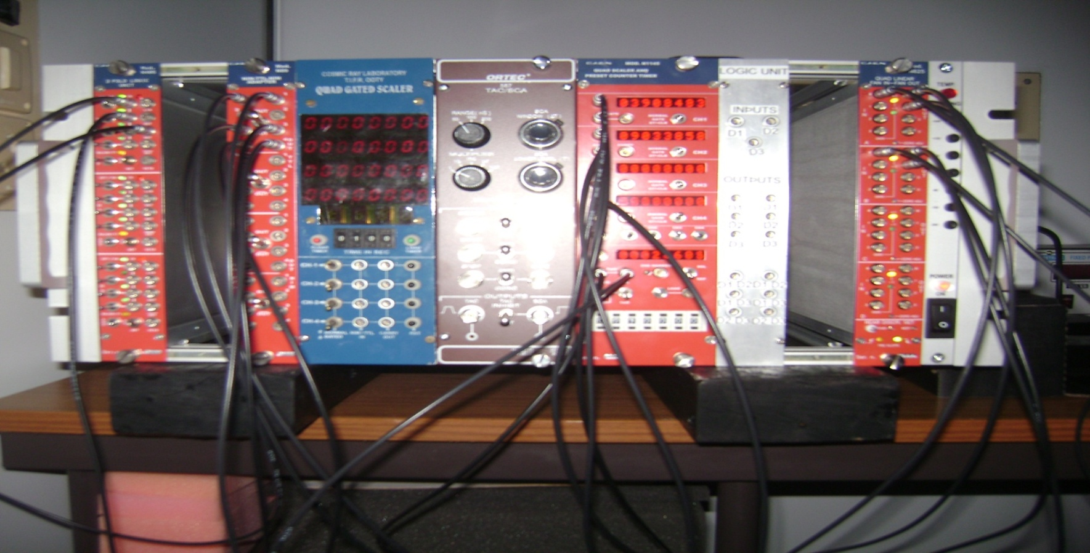
NIM module
NIM coincidence modules are simple to use.
“time-to-amplitude”convert the delay between two pulses to a pulse with a height proportional to the delay.
A single channel analyzer is used for selecting the pulses from down-converted photon pairs.
A multichannel scaler is very useful in helping set the window of the single-channel analyzer.
Notes:
34
34
34

Slide 35
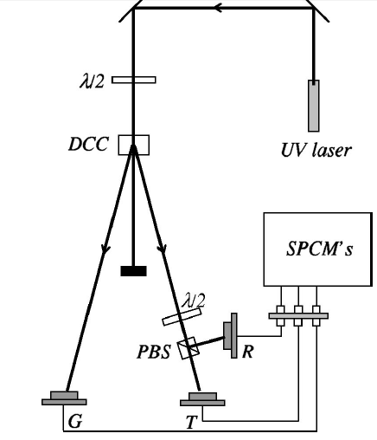
Experiment-2
Photon cannot be split
P. Grangier, G. Roger, and A. Aspect, ‘‘Experimental evidence for a photon anticorrelation effect on a beam splitter: A new light on single-photon interferences,’’ Europhys. Lett. 1, 173–179 (1986)

Slide 36
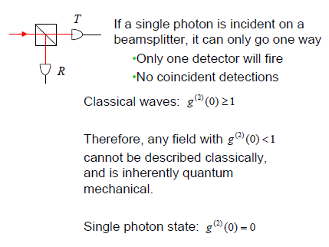
“ a single photon can only be detected once”
P. Grangier et al.

Slide 37
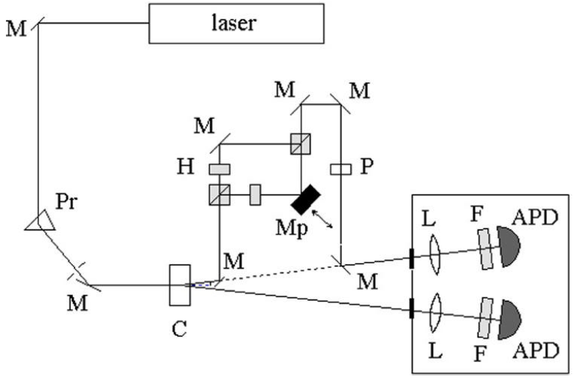
Experiment-3
Mach-Zehnder interferometer

Slide 38
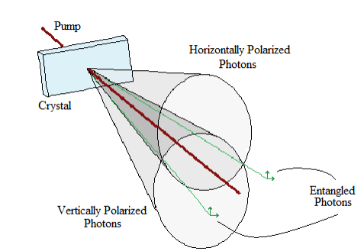
Entanglement
Notes:
38

Slide 39
Interference experiment
Hanbury-Brown Twiss test
Bomb Experiment
Quantum eraser
Hong–Ou–Mandel Interferometer
Biphoton Interference
Polarizer as a wave function projector
Entanglement Testing Local Realism
Other experiments

Slide 40
Optical realization of quantum computation and
communication
Jian-Wei Pan, Dik Bouwmeester, Harald Weinfurter, and Anton Zeilinger, Experimental Entanglement Swapping: Entangling Photons That Never Interacted, vol. 80, p. 3891, 1998
Thomas Jennewein et al., A. C ernoch, J. Soubusta, L. Bartuskova, M. Dusek, and J. Fiurasek, Experimental realization of linear-optical partial SWAP gates, Phys. Rev. Lett., 100 (2008) 180501.
C. -Y. Lu, T. Yang, and J. -W. Pan, Experimental Multiparticle Entanglement Swapping for Quantum Networking, Physical Review Letters 103, 020501 (2009)
Juan Yin et al., Xiao-song Ma et al., Experimental delayed-choice entanglement swapping, NATURE PHYSICS, 8(2012)
ED Lopaeva, I Ruo Berchera, IP Degiovanni, S Olivares, G Brida, M Genovese, Experimental realization of quantum illumination, Physical review letters, 110(2013) 153603.
Shashi Prabhakar, Salla Gangi Reddy, A. Aadhi, Ashok Kumarb P. Chithrabhanu, G.K. Samanta, R.P. Singh, Spatial distribution of Spontaneous Parametric Down-Converted Photons for higher order Optical Vortices, Optics Communications 326 (2014) 64.
Koji Azuma, Kiyoshi Tamaki & Hoi-Kwong Lo , All-photonic quantum repeaters, Nature Communications 6, Article number: 6787, 2015
Xiao-Song Ma et al., Quantum teleportation over 143 kilometres using active feed-forward, Nature 489, 269273 (2012)
F. Bussières et al., Quantum teleportation from a telecom-wavelength photon to a solid-state quantum memory, Nature Photonics 8 (2014) 775778
Xi-Lin Wang, Quantum teleportation of multiple degrees of freedom of a single photon, Nature 518 (2015) 516519.
Many works

Slide 41
Distributed Qubits interact with the environment
!
Problem
Gets noisy due to storage processing and transmission
The IDEA is that the two distant parties Alice and
Bob are supplied with finite ensemble of pure states
from which they wish to extract the
maximally entangled states (MESs).
Entanglement concentration transforms a pure non maximally entangled state into MES
Entanglement distillation transforms a mixed non maximally entangled state into MES

Slide 42
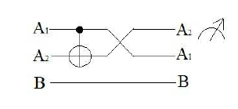
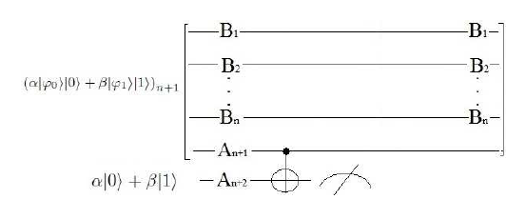
Qubit-assisted optimal ECP
We need a CNOT or a TWO QUBIT ENTANGLING GATE
Quantum citcuit for qubit-assisted optimal ECP
proposed by S. Bandyopadhyay in circuit form.

Slide 43
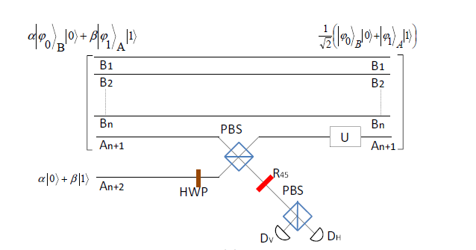
Schematic diagram of optical quantum circuits for implementation of an ECP using (a) linear optical elements, and (b) nonlinear (Kerr medium) and linear optical elements.
(a)
(b)

Slide 44
TEAM
Dr. Somshubhro Bandyopadhyay
Dr. Achintya Singha
Saronath Halder
Prasenjit Dev
{
}
Special thanks to
Prof. Anirban Pathak, Prof. R P Singh
Prof. Konrad Banasaek
Chitrabhanu and PRL optic optics group
for motivation and support.

Slide 45
Thank You!

