Slide 1
Gibbs’ Paradox and Quantum Information
Unnikrishnan. C. S.
Gravitation Group & Fundamental Interactions Lab
Tata Institute of Fundamental Research
Homi Bhabha Road, Mumbai 400005

Slide 2
Plan of the talk:
Description of the Gibbs problem of entropy of mixing of gases
Description of the conventional resolution
The problem of (dis)continuity
Discussion of the ingredients of resolution → Indistinguishability and QM
Discussion of dissenting views
Is QM necessary? If so, quantum information will be decisive.
What exactly is indistinguishability for statistical mechanics and entropy?
Summary of my (integrating) views

Slide 3
Entropy:
Thermodynamics
Statistical mechanics
Information theory
In a ‘random’ experiment with W outcomes, p=1/W
Average over several such partitions with prob. p_{i}
?
Landauer, Jaynes, Bennett…
Irreversibility as a crucial issue.
Completely reversible computation (Toffoli etc.)

Slide 4
E. T. Jaynes, ‘The Gibbs Paradox’, In Max. entropy and Bayesian methods (1992)
Some important facts about thermodynamics have not been understood by others to this day, nearly as well as Gibbs understood them over 100 years ago...
…But recognizing this should increase rather than decrease our confidence in the future of the second law, because it means that if an experimenter ever sees an apparent violation, then instead of issuing a sensational announcement, it will b e more prudent to search for that unobserved degree of freedom. That is, the connection of entropy with information works both ways; seeing an apparent decrease of entropy signifies ignorance of what were the relevant macrovariables.
…the whole question of in what way or indeed, whether classical mechanics failed in comparison with quantum mechanics in the matter of entropy, now seems to be reopened.
Recognizing this, it is not surprising that entropy has been a matter of unceasing confusion and controversy from the day Clausius discovered it. Different people, looking at different aspects of it, continue to see different things because there is still unfinished business in the fundamental definition of entropy, in both the phenomenological and statistical theories.
…further theoretical work will b e needed before we can claim to understand entropy.

Slide 5
“You should call it entropy, for two reasons. In the first place, your uncertainty function has been used in statistical mechanics under that name, so it already has that name. In the second place, and more important, no one knows what entropy really is, so in a debate you will always have the advantage”.
J. von Neumann, C. Shannon to M. Tribus (1961).

Slide 6
V
V/2
V/2
V/2
V/2
V

Slide 7
Requirements and problems:
Change in entropy should be zero for mixing of the same gas
It should be Nk_{B} ln2 for two different species of gases
The change in entropy does not seem to depend on the magnitude of “sameness”
Hence, the change is discontinuous on the parameter ‘sameness’
Core issue: How was the expression for entropy derived?

Slide 8
So called classical counting:
The Gibbs indistinguishability correction:
Problem of entropy of mixing solved, but provoked century+ old discussions…

Slide 9
Problem of entropy of mixing solved, but provoked century+ old discussions…
How does one decide when to divide by N! Is entropy a matter of subjective abilities on distinguishability?
How does nature decides when to increase entropy and when not?
What is an operational and reliable definition of indistinguishability?
Why are classical particles distinguishable? Are they really? Or do we need quantum mechanics to justify indistinguishability of identical particles?

Slide 10
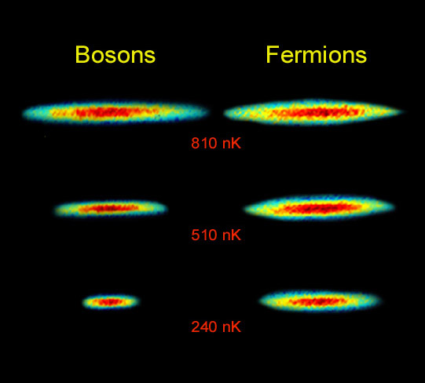
Quantum mechanics and Indistinguishability
D1
S1
S2
S2
D2
S1
Interference
V
V/2
V/2

Slide 11
Another counting exercise:
n₂
n₁
Compare with

Slide 12
Classical identicalness and indistinguishability
Conventionally considered distinguishable through Newtonian histories
But statistical physics shouldn’t care… since nature does not!
Nor does classical information theory.
V
V/2
V/2

Slide 14
Language and representation of Information
INFORMATION
1000101110000 Indistinguishability of permutations
Indistinguishable material entities as holders of information (bits)
Their Physical states as Information →
Change in physical state is change in information

Slide 15
Criterion for distinguishability
V/2
V/2
V
V/2
V/2
V
Distinguishability = Physical separability, in principle.
If the system is differentially sensitive to external force fields (interactions), it is separable and distinguishable (for example, the tiniest of charge on one species and nothing on other).
However, slightly different charges on both should translate to some indistinguishability. That is where a more precise formulation in term of QM states comes in. Full distinguishability is equivalent to orthogonality of states.

Slide 16
Entropy of “Unmixing”:
V/2
V/2
V
Requires a physical process involving external forces, or a filter operating on the physical difference. Energy has to be pumped into the system, because un-mixing cannot happen spontaneously.
The efficiency of un-mixing depends on

Slide 17
Entropy:
Thermodynamics
Statistical mechanics
Information theory
In a ‘random’ experiment with W outcomes, p=1/W
Average over several such partitions with prob. p_{i}
?
Landauer, Jaynes, Bennett…
Irreversibility as a crucial issue.
Completely reversible computation (Toffoli etc.)

Slide 18
Entropy of parts and the whole:
Two-particle maximally entangled state and its (unmeasured) single particle parts…
The single particle parts are not ‘prepared’ as a mixture, and yet they are entropically. different in their local partitions. There is no Extesnsivity.

Slide 19
Conclusions:
A resolution of the Gibbs’ paradox requires a clear understanding of the notion of indistinguishability, but this is not specific to QM – hence QM is not an essential ingredient for its resolution.
However, QM notion of states and orthogonality is needed to define a measure for sameness, or indistinguishability. Once this is done, the problem of discontinuity disappears.
Classical information theory is sufficient to formulate and resolve the issue unambiguously, but quantitative continuous description requires the QM notion of states.
However, there is really no classical world! In that sense, QM is essential to resolve ANY physical problem, including the Gibbs paradox and the related issues of Maxwell’s demon etc.

