Slide 1

Monogamy of Quantum Correlations
Aditi Sen (De)
Harish-Chandra Research Institute, India

Slide 2
Monogamy of Quantum Correlations
Aditi Sen (De)
Harish-Chandra Research Institute, India
Co-workers: Asutosh, Salini, Arun, Prabhu, Ujjwal

Slide 3
Outline
What is monogamy of quantum correlations?
Quantum Correlations
Entanglement-Separability paradigm
Information-theoretic paradigm
Info-theoretic measures: nonmonogamous (3-qubits)
R quantum correlations monogamous?
Powers of QC r monogamous
QC r monogamous for higher no of parties

Slide 4
Outline
What is monogamy of quantum correlations?
Quantum Correlations
Entanglement-Separability paradigm
Information-theoretic paradigm
Info-theoretic measures: nonmonogamous (3-qubits)
R quantum correlations monogamous?
Powers of QC r monogamous
QC r monogamous for higher no of parties

Slide 5
Outline
What is monogamy of quantum correlations?
Quantum Correlations
Entanglement-Separability paradigm
Information-theoretic paradigm
Info-theoretic measures: nonmonogamous (3-qubits)
R quantum correlations monogamous?
Powers of QC r monogamous
QC r monogamous for higher no of parties

Slide 6
Outline
What is monogamy of quantum correlations?
Quantum Correlations
Entanglement-Separability paradigm
Information-theoretic paradigm
Info-theoretic measures: nonmonogamous (3-qubits)
R quantum correlations monogamous?
Powers of QC r monogamous
QC r monogamous for higher no of parties

Slide 7
Outline
What is monogamy of quantum correlations?
Quantum Correlations
Entanglement-Separability paradigm
Information-theoretic paradigm
Info-theoretic measures: nonmonogamous (3-qubits)
R quantum correlations monogamous?
Powers of QC r monogamous
QC r monogamous for higher no of parties

Slide 8
Outline
What is monogamy of quantum correlations?
Quantum Correlations
Entanglement-Separability paradigm
Information-theoretic paradigm
Info-theoretic measures: nonmonogamous (3-qubits)
R quantum correlations monogamous?
Powers of QC r monogamous
QC r monogamous for higher no of parties

Slide 9
Outline
What is monogamy of QC?
Quantum Correlations
Entanglement-Separability paradigm
Information-theoretic paradigm
Info-theoretic measures: nonmonogamous (3-qubits)
R quantum correlations monogamous?
Powers of QC r monogamous
QC r monogamous for higher no of parties

Slide 10
What is monogamy?

Slide 11
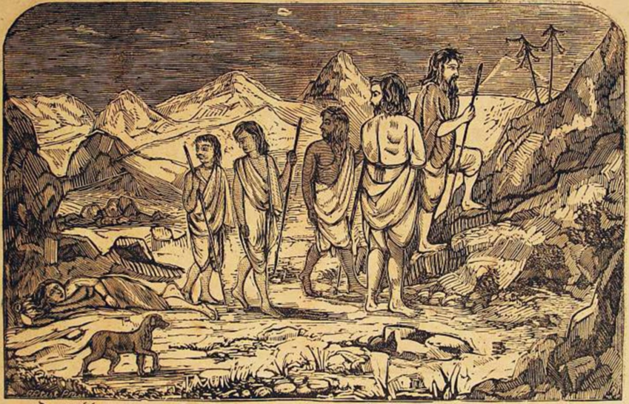
What is monogamy?
Scene from Mahabharata

Slide 12

What is monogamy?
Monogamy
Scene from Mahabharata

Slide 13
What is monogamy?
Is sharing QCs between several parties restricted?

Slide 14




What is monogamy?
A
B
C

Slide 15
What is monogamy?
A
Maximal QC
B
C

Slide 16
What is monogamy?
A
Maximal QC
No QC
B
C

Slide 17
What is monogamy?
If A and B have maximal QC,
they cannot be quantum correlated, at all with C
A
Maximal QC
No QC
B
C
Ekert, PRL’91; Bennett, Brassard, Mermin, PRL’92
C.H. Bennett, et al., PRA 53, 2046 (’96)

Slide 18
What is monogamy?
If A and B have maximal QC,
they cannot be quantum correlated, at all with C
A
Maximal QC
No QC
B
C

Slide 19
What is monogamy?
A
Highly QC
Weakly QC
B
C

Slide 20
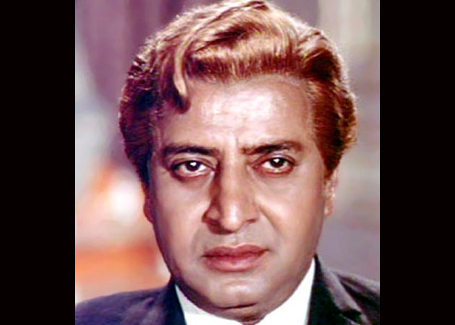
What is monogamy?
A
Sender
Highly QC
Receiver
B
C
Eavesdropper
Main ingredient of quantum cryptography

Slide 21
What is monogamy?
A
High CC
High CC
B
C
Classical correlations do not follow!!

Slide 22
What is monogamy?
A
Highly QC
Weakly QC
B
C
Trade-off between the amount of QCs
between A-B and A-C -- Monogamy

Slide 23

Monogamy-Quantification
Monogamy relation for QC measure
A
B
C

Slide 24
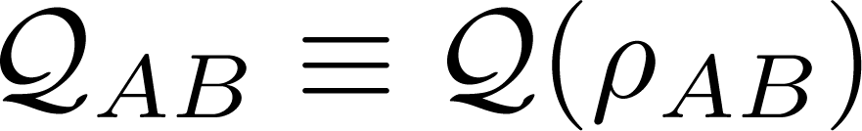
Monogamy-Quantification
Monogamy relation for QC measure
A
B
C

Slide 25

Monogamy-Quantification
Monogamy relation for QC measure
A
B
C

Slide 26

Monogamy-Quantification
Monogamy relation for QC measure
A
B
C

Slide 27
Monogamy-Quantification
A
B
If is monogamous, then
C
Coffman, Kundu, Wootters, PRA 61, 052306 (’00)

Slide 28

Monogamy-Quantification
N+1-party case
A
B₁
B₂
B_{N}
If is monogamous, then

Slide 29
Monogamy of concurrence
CKW,PRA’00; Osborne, Verstraete, PRL ’06
A
B₁
B₂
B_{N}
Squared Concurrence is monogamous

Slide 30
Monogamy-Quantification
A
Multiparty Properties by bipartite measures
B₁
B₂
B_{N}

Slide 31
Outline
What is monogamy of quantum correlations?
QC measures
Entanglement-Separability paradigm
Information-theoretic paradigm
Info-theoretic measures: nonmonogamous (3-qubits)
R quantum correlations monogamous?
Powers of QC r monogamous
QC r monogamous for higher no of parties

Slide 32


Entanglement measures
Is it entangled?
Notes:
32

Slide 33
Entanglement measures
Is it entangled?
Qualitative query
Notes:
33

Slide 34
Entanglement measures
Is it entangled?
How much?
Qualitative query
Quantitative query
Notes:
34

Slide 35
Entanglement measures
Is it entangled?
How much?
For 2 spin-1/2 particles,
Entanglement: well – understood
qualitatively, quantitatively
Notes:
35

Slide 36
Entanglement Measures
Ent of Formation, Concurrence
Logarithmic Negativity
Wootters, PRL 80, 2245 (’98)
Vidal, Werner, PRA 65, 2245 (1998)

Slide 37



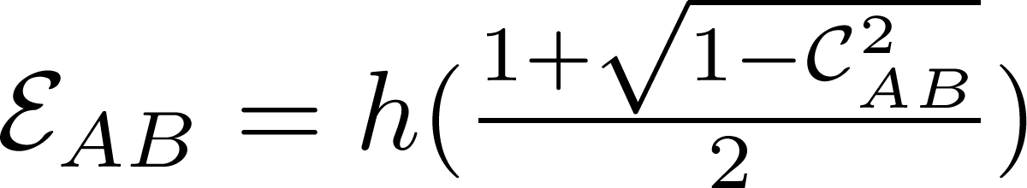
Ent of Formation
Concurrence:
λ’s are the square root of the eigen values of

Slide 38
Ent of Formation
Concurrence:
λ’s are the square root of the eigen values of

Slide 39
Ent of Formation
Concurrence:
Computable measure
λ’s are the square root of the eigen values of

Slide 40


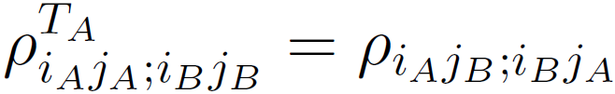
Log Neg
: absolute sum of negative eigenvalues of
Partial transpose:

Slide 41
Log Neg
: absolute sum of negative eigenvalues of
Computable measure
Partial transpose:

Slide 42
Information-theoretic Measures
Quantum Discord
Quantum Work-deficit
Olliver&Zurek, Henderson & Vedral ’01
Oppenheim. Horodeccy, ASD, Sen ’03

Slide 43
Quantum discord
Mutual information
for classical random variables.
H = Shannon Entropy
H(Y)
H(X)
H(X|Y)
H(Y|X)
H(X,Y)
H(X) + H(Y) – H(X,Y)
H(X) – H(X|Y)
or
Notes:
4083 (manab) 4055 (nju verma)

Slide 44
Quantum discord
Quantizing them produces
inequivalent quantities
for bipartite quantum states.
H(Y)
H(X)
H(X|Y)
H(Y|X)
H(X,Y)
H(X) + H(Y) – H(X,Y)
H(X) – H(X|Y)
or
Notes:
4083 (manab) 4055 (nju verma)

Slide 45
Quantum discord
Quantizing them produces
inequivalent quantities
for bipartite quantum states.
H(Y)
H(X)
H(X|Y)
H(Y|X)
The difference is called Discord.
H(X,Y)
H(X) + H(Y) – H(X,Y)
H(X) – H(X|Y)
or
Notes:
4083 (manab) 4055 (nju verma)

Slide 46
Quantum discord
H(Y)
H(X)
Discord
Total Corr
Classical Corr
H(X|Y)
H(Y|X)
The difference is called Discord.
H(X,Y)
S(X) + S(Y) – S(X,Y)
S(X) – S(X|Y)
or
Notes:
4083 (manab) 4055 (nju verma)

Slide 47
Quantum Work-deficit
WD
Global work
Local Work
H(X|Y)
H(Y|X)
The difference is called WD

Slide 48
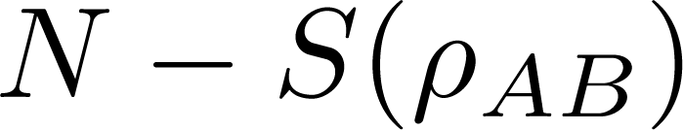
Quantum Work-deficit
WD
Global work
Local Work
H(X|Y)
H(Y|X)
The difference is called WD

Slide 49
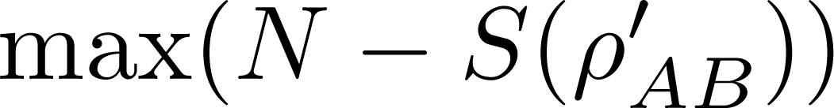
Quantum Work-deficit
WD
Global work
Local Work
H(X|Y)
H(Y|X)
The difference is called WD

Slide 50
Outline
What is monogamy of quantum correlations?
Quantum Correlations
Entanglement-Separability paradigm
Information-theoretic paradigm
Info-theoretic measures: nonmonogamous
(3-qubits)
R quantum correlations monogamous?
Powers of QC r monogamous
QC r monogamous for higher no of parties

Slide 51
Questions
Does quantum discord satisfy monogamy relation?
Does the sharing of quantum discord follow the same broad guidelines that are followed by entanglement?

Slide 52
Questions
Does quantum discord satisfy monogamy relation?
Does the sharing of quantum discord follow the same broad guidelines that are followed by entanglement?

Slide 53


Monogamy of Q Discord
For tripartite state
Does it hold?

Slide 54
Monogamy of Q Discord
For tripartite state
Does it hold?
a000 + b111 → generalized GHZ

Slide 55
Monogamy of Q Discord
For tripartite state
Does it hold?
a000 + b111 → generalized GHZ

Slide 56
Monogamy of Q Discord
For tripartite state
Does it hold?
c001 + d010 + e100 → generalized W

Slide 57
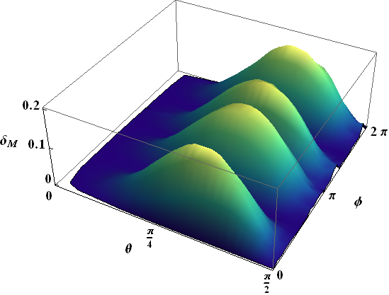
Monogamy of Q Discord
Does it hold?
c001 + d010 + e100 → generalized W

Slide 58
Monogamy of Q Discord
Does it hold?
c001 + d010 + e100 → generalized W
Prabhu, Pati, ASD, Sen, PRA 86 040102(R)’12

Slide 59
Quantum discord is nonmonogamous

Slide 60
Quantum discord is nonmonogamous
What is it useful for?

Slide 61
GHZ vs W
a000 + b111 → generalized GHZ
c001 + d010 + e100 → generalized W

Slide 62
GHZ vs W
a000 + b111 → generalized GHZ
c001 + d010 + e100 → generalized W
SLOCC

Slide 63
GHZ vs W
a000 + b111 → generalized GHZ
c001 + d010 + e100 → generalized W
Monogamy of discord can distinguish them.

Slide 64
GHZ vs W
a000 + b111 → generalized GHZ
c001 + d010 + e100 → generalized W
Monogamy of discord can distinguish them.
GHZs are monogamous.
Ws are polygamous.

Slide 65
GHZ vs W
Positive port
{Gen GHZ, Gen W}
Monogamy of discord test
S
Negative port

Slide 66
GHZ vs W
Gen GHZ
>0
{Gen GHZ, Gen W}
Monogamy of discord test
S
<0

Slide 67
Results for Discord monogamy test
Tripartite states | Discord Monogamy | Monogamy test result
Gen GHZ | >0 | Satisfy
Gen W | < 0 | Violate
GHZ class | 90%-->0 10%--<0 | Satisfy Violate
W class | < 0 | Violate
Prabhu, Pati, ASD, Sen, PRA 86 040102(R) (’12)
Giorgi, PRA 84, 054301 (’11)

Slide 68
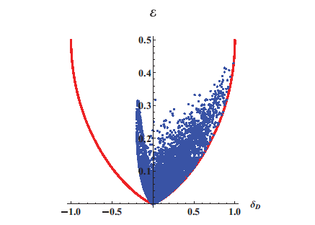
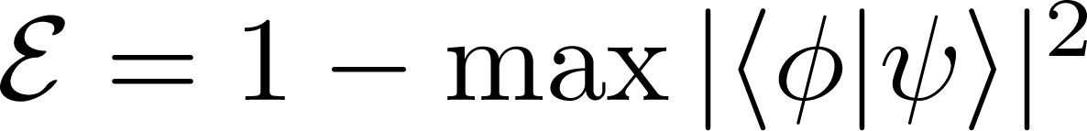
Monogamy of QD
Prabhu, Pati, ASD, Sen, PRA 86, 052337 (’12)

Slide 69
Quantum discord is nonmonogamous
What is it useful for?

Slide 70
NMR

Slide 71
NMR
Monogamy of discord helps to distinguish two phases in many-body system

Slide 72


NMR

Slide 73
NMR
Koteswar Rao, Katiyar, Mahesh, ASD, Sen, Kumar, PRA 2013

Slide 74
Outline
What is monogamy of quantum correlations?
Quantum Correlations
Entanglement-Separability paradigm
Information-theoretic paradigm
Info-theoretic measures: nonmonogamous (3-qubits)
R quantum correlations monogamous?
Powers of QC r monogamous
QC r monogamous for higher no of parties

Slide 75
Powers of QC
QC | Concurrence (C) | EoF (E) | Discord (D) | C² | E² | D²
Monogamy
Polygamy

Slide 76
Powers of QC
Theorem:
If violates monogamy,  an increasing function s.t

Slide 77
Powers of QC
Theorem:
If violates monogamy,  an increasing function s.t
provided is monotonically decreasing under discarding system
& invariance under discarding systems occurs only for monogamy satisfying states

Slide 78
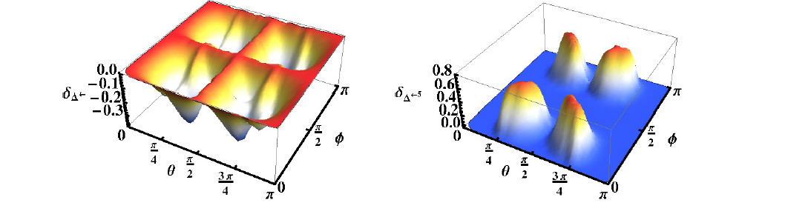
Powers of WD: gen W state
Polygamy of WD for W
Monogamy of (WD)⁵ for W
c001 + d010 + e100 → generalized W
Salini, Prabhu, ASD, Sen, 2012

Slide 79
Powers of WD: gen W state
Polygamy of WD for W
Monogamy of (WD)⁵ for W
c001 + d010 + e100 → generalized W
Salini, Prabhu, ASD, Sen, 2012

Slide 80
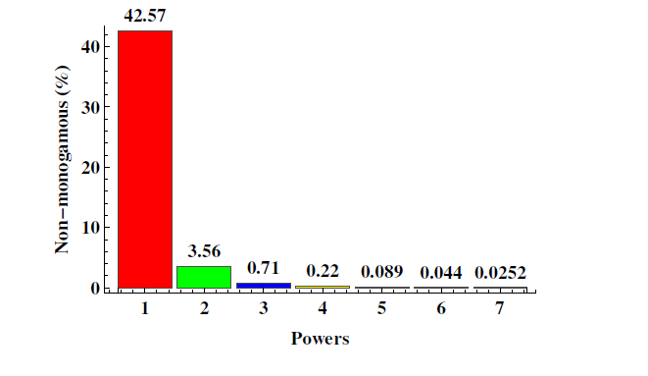
Powers of WD: Monogamous
Salini, Prabhu, ASD, Sen, 2012

Slide 81
Powers of WD: Monogamous
Randomly generated 3-qubit states
by Haar measure
Salini, Prabhu, ASD, Sen, 2012

Slide 82
Powers of WD: Monogamous
Randomly generated 3-qubit states
by Haar measure
of WD
Salini, Prabhu, ASD, Sen, 2012

Slide 83
Monogamy of WD
Theorem:
WD is monogamous Discord is monogamous
For pure 3-party state

Slide 84

Monogamy of WD
Theorem:
WD is monogamous Discord is monogamous
For pure 3-party state
This is because

Slide 85
Outline
What is monogamy of quantum correlations?
Quantum Correlations
Entanglement-Separability paradigm
Information-theoretic paradigm
Info-theoretic measures: nonmonogamous (3-qubits)
R quantum correlations monogamous?
Powers of QC r monogamous
QC r monogamous for large no of parties

Slide 86
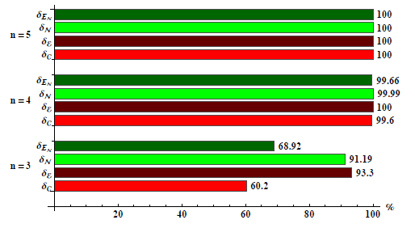
Large no. of parties help to get monogamy
Randomly generated states:

Slide 87
Large no. of parties help to get monogamy
Concurrence
EoF
Negativity
Log-negativity
Discord
Work-deficit

Slide 88
Large no. of parties help to get monogamy
Asutosh’s poster
Randomly generated states: All QCs become monogamous
for large no. of parties
Asutosh, Prabhu, ASD, Sen, arXiv: 1312:6640

Slide 89
Conclusion
Information theoretic measures r nonmonogamous
3 qubits

Slide 90
Conclusion
Information theoretic measures r nonmonogamous
Powers of QCs r monogamous

Slide 91
Conclusion
Information theoretic measures r nonmonogamous
Powers of QCs r monogamous
Large no of parties enforce monogamy

Slide 92
Conclusion
Information theoretic measures r nonmonogamous
Powers of QCs r monogamous
Large no of parties enforce monogamy
arXiv:1312.6640
arXiv:1206.4029
PRA ’13
PRA ’12

Slide 93


